Slide 1

MOBILE DATA ACQUISITION SYSTEM MODA

Slide 2
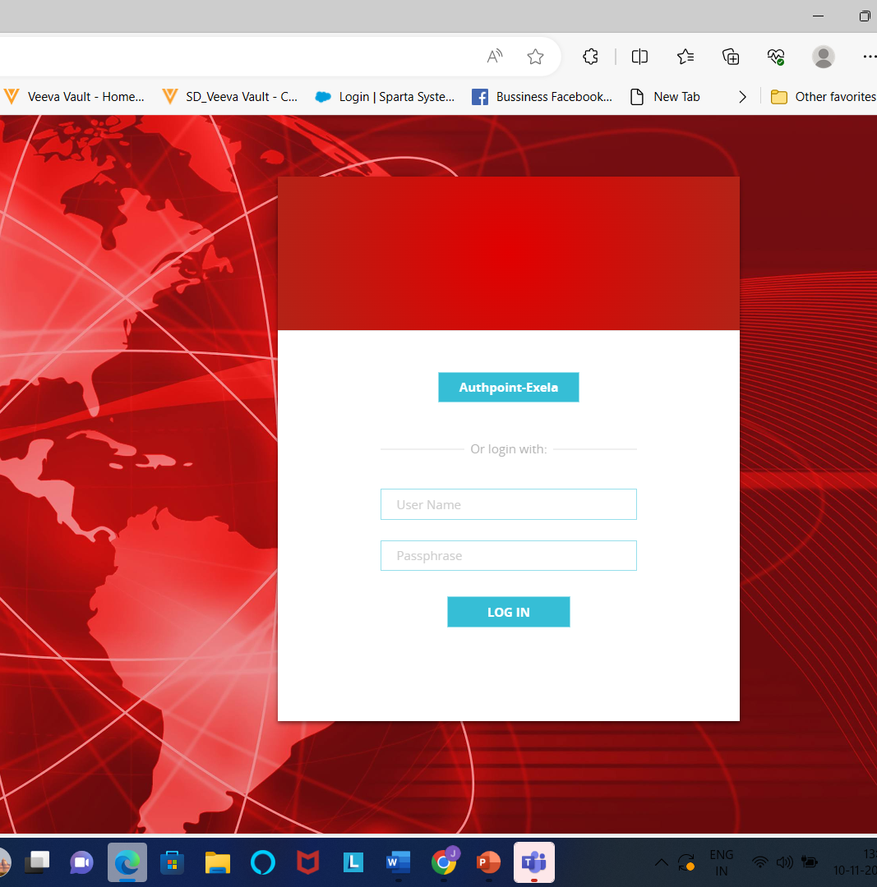
Home page of MODA
1. Here We must give our Credentials Username and password to open .
2. After giving Credentials Application page will open it is IndiaModa4.

Slide 3
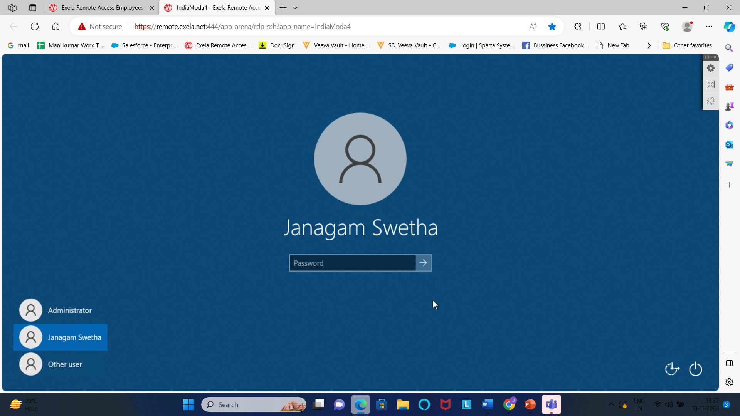
MODA
When we click on Applications, Administrator page will open then click on your name and give password.

Slide 4
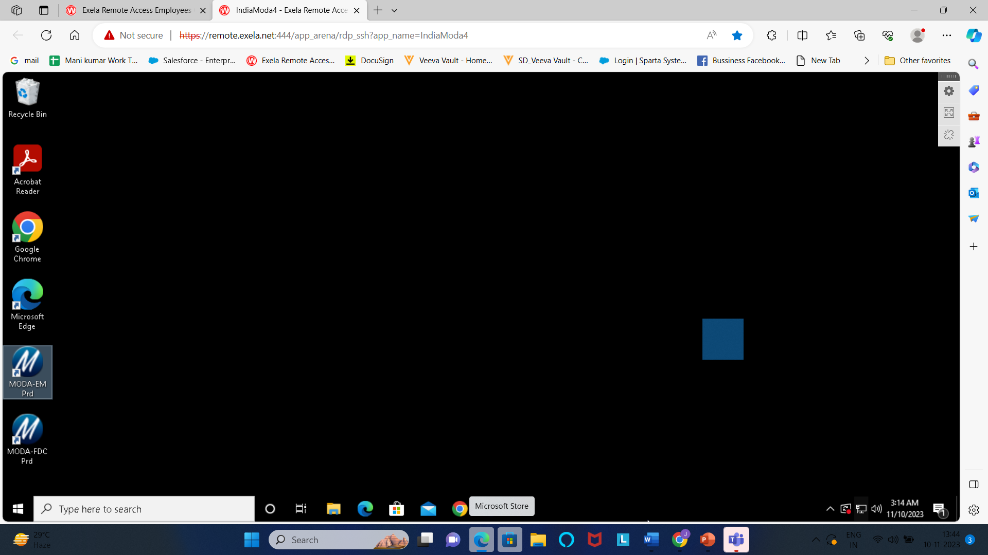
MODA
After giving password on Administrator page the MODA-EM Prd page will open give Double click on that MODA – EM Prd and again we must give our Username and password.

Slide 5
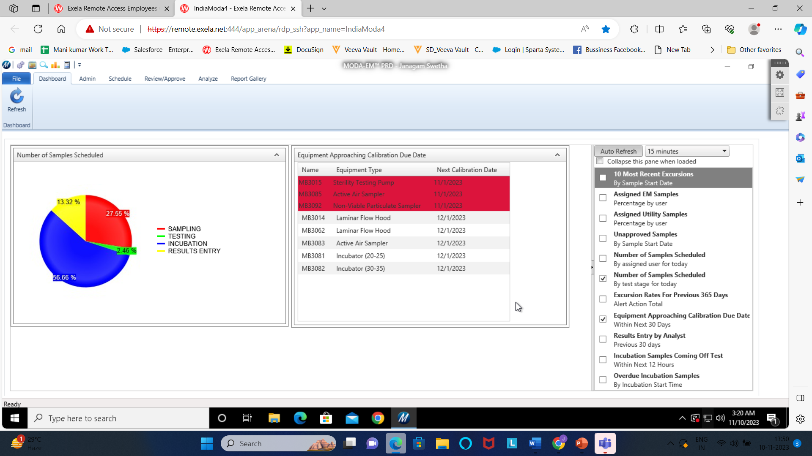
MODA
After giving the Credentials, the MODA page will open.

Slide 6
MODA
In MODA there are Two type of Categories
1. No Test/Non-Approved Category
2. Complete/Non-Approved Category

Slide 7
No Test/Non approved category
In No -Test category we have different types of test methods,
1)Surface monitoring
2) Personnel monitoring
3)Active and passive viable Air monitoring
4)Non-Viable particulate
5)Bioburden testing and Bioburden In-process
6)TOC & Conductivity
7)Compressed Air monitoring
8)Endotoxin Testing & In –process
9)Growth promotion

Slide 8
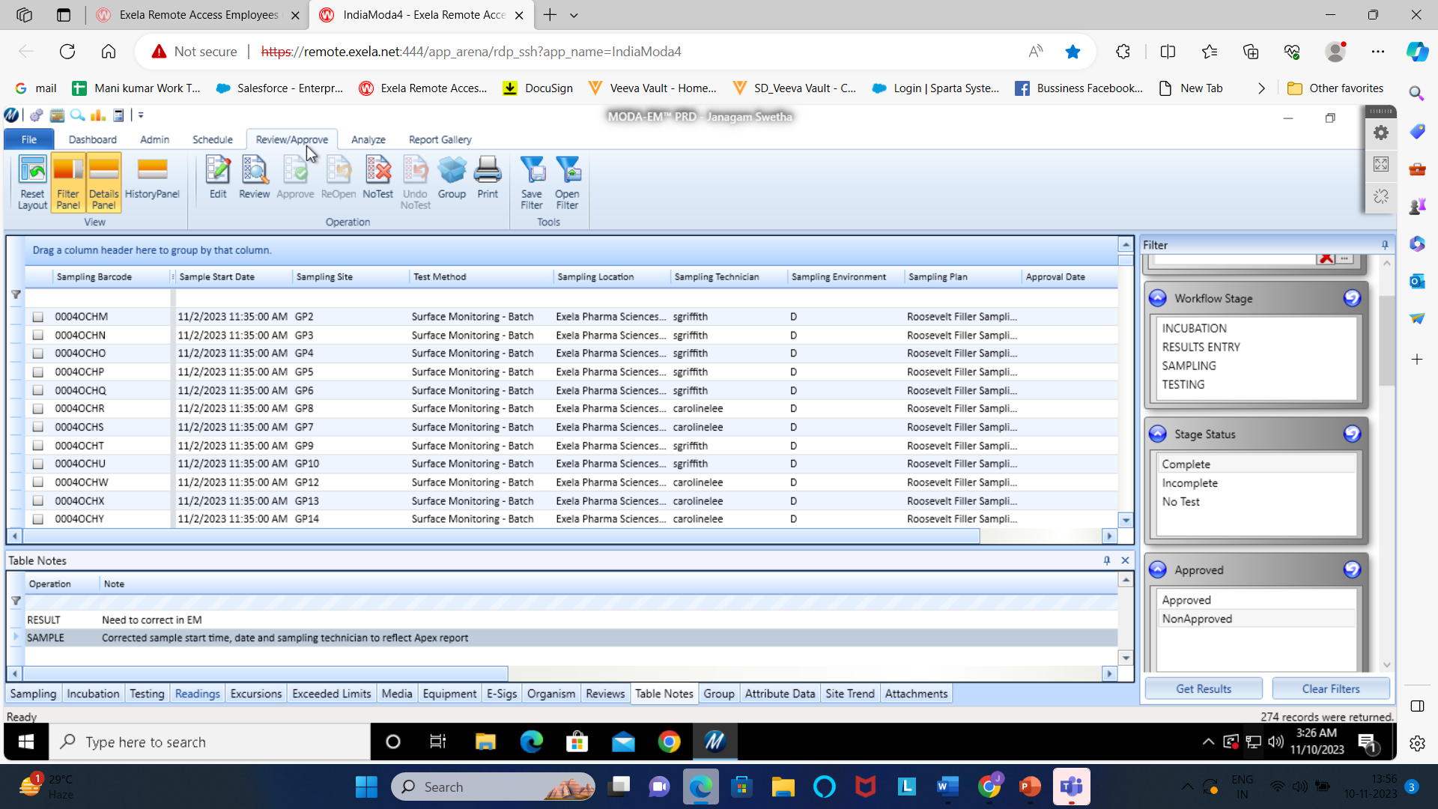
MODA
To approve the No-test /Non-Approved Category Related barcodes we must click on Review and Approve, and then do the Clear filters and select No Test/ Non-Approved then click on Get Results.

Slide 9
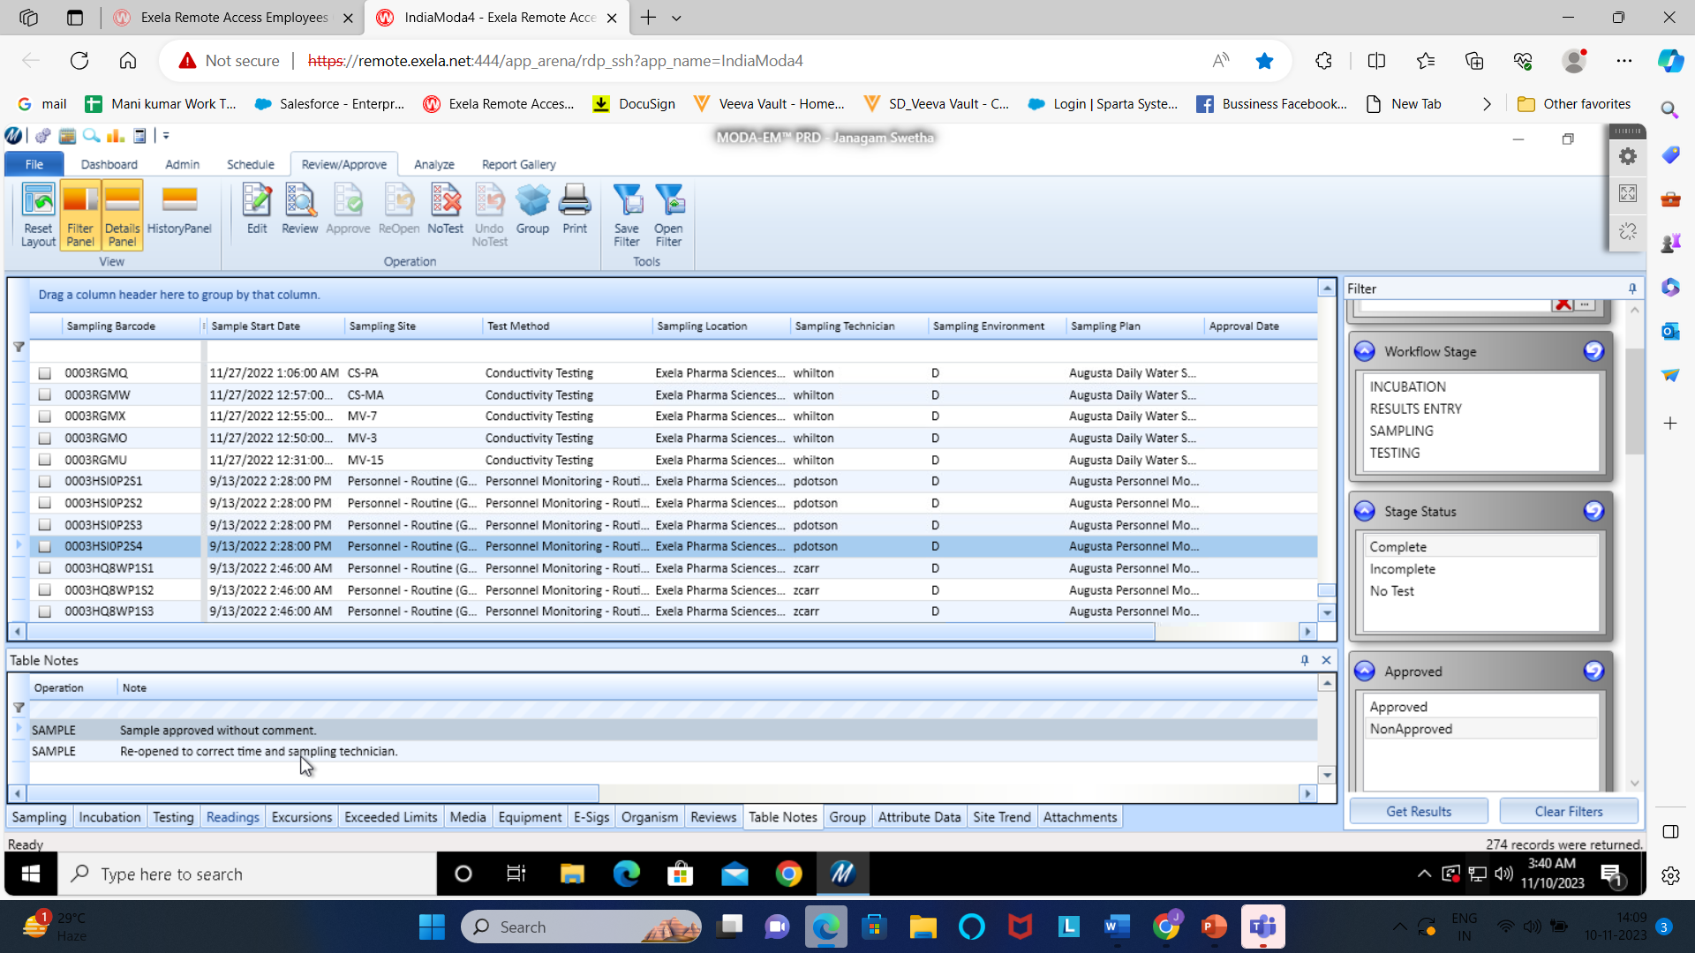
MODA
In MODA we have 16 different types of tabs, but in No test/Non approved Category we are using only two tabs Table notes and Media by checking these two tabs we must approve the barcode.
Firstly, We must check the Table notes ,in table notes tab if they mentioned as Reopen for correction, we should not approve the barcode until it corrected.

Slide 10
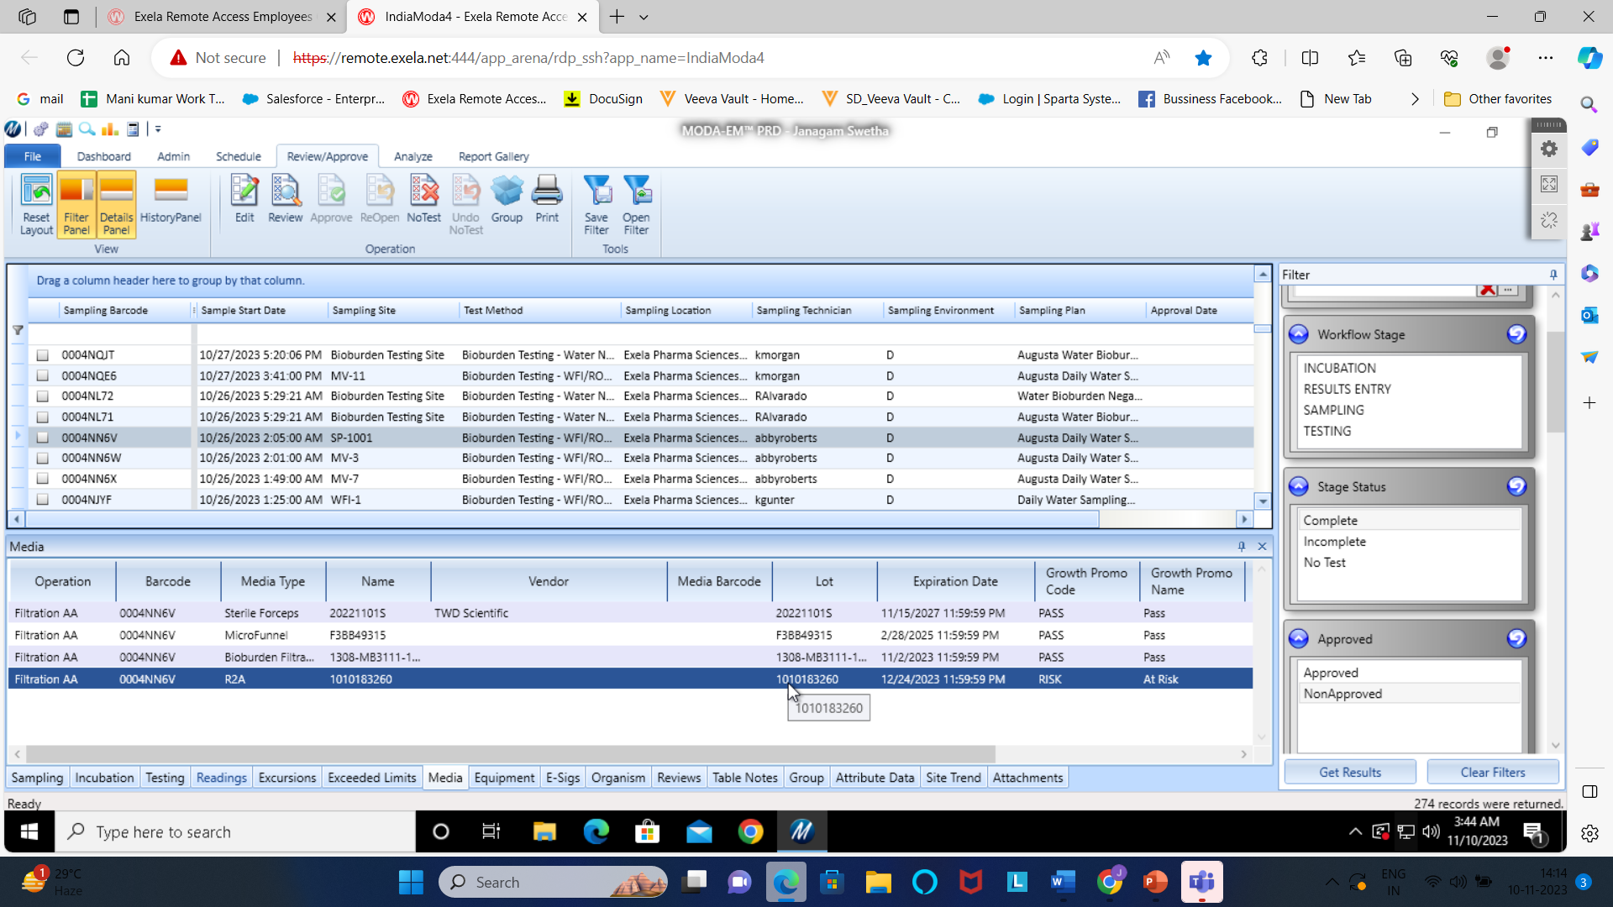
MODA
Next Check the Media in media tab if the Lot number is mentioned as Risk, the risk related barcodes should not approve.
We must send the Information to the upper management through the Email or mention in MODA Queries list.

Slide 11
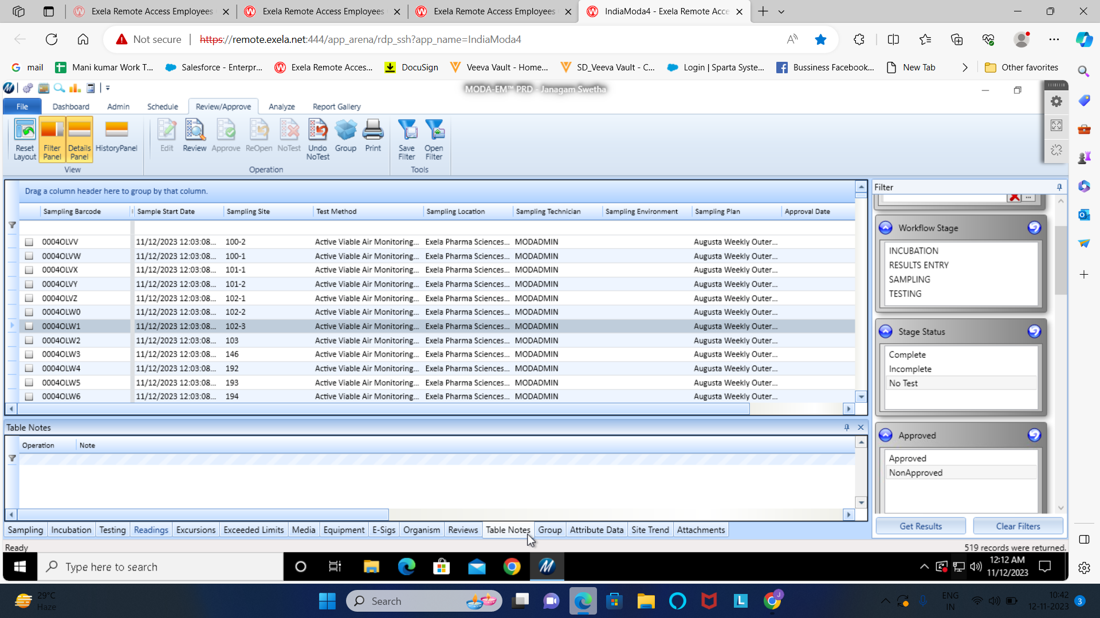
MODA
If the Sampling technician is mentioned as Moda Admin there will be no comments in Sampling tab and Media tab, we must approve the barcodes.

Slide 12

Thank you

